Slide 1
GWC Spring Session 8!
April 19, 2021
Notes:
Names: Hannah, Megan, Zuha, Ana + Paula, Angel, Sasha, Nina

Slide 2
Today’s Agenda
Accounts and Software Check
Finish robot arm – do the code!
Stand ups

Slide 3
Finish Robot Arm - Cxt

Slide 4
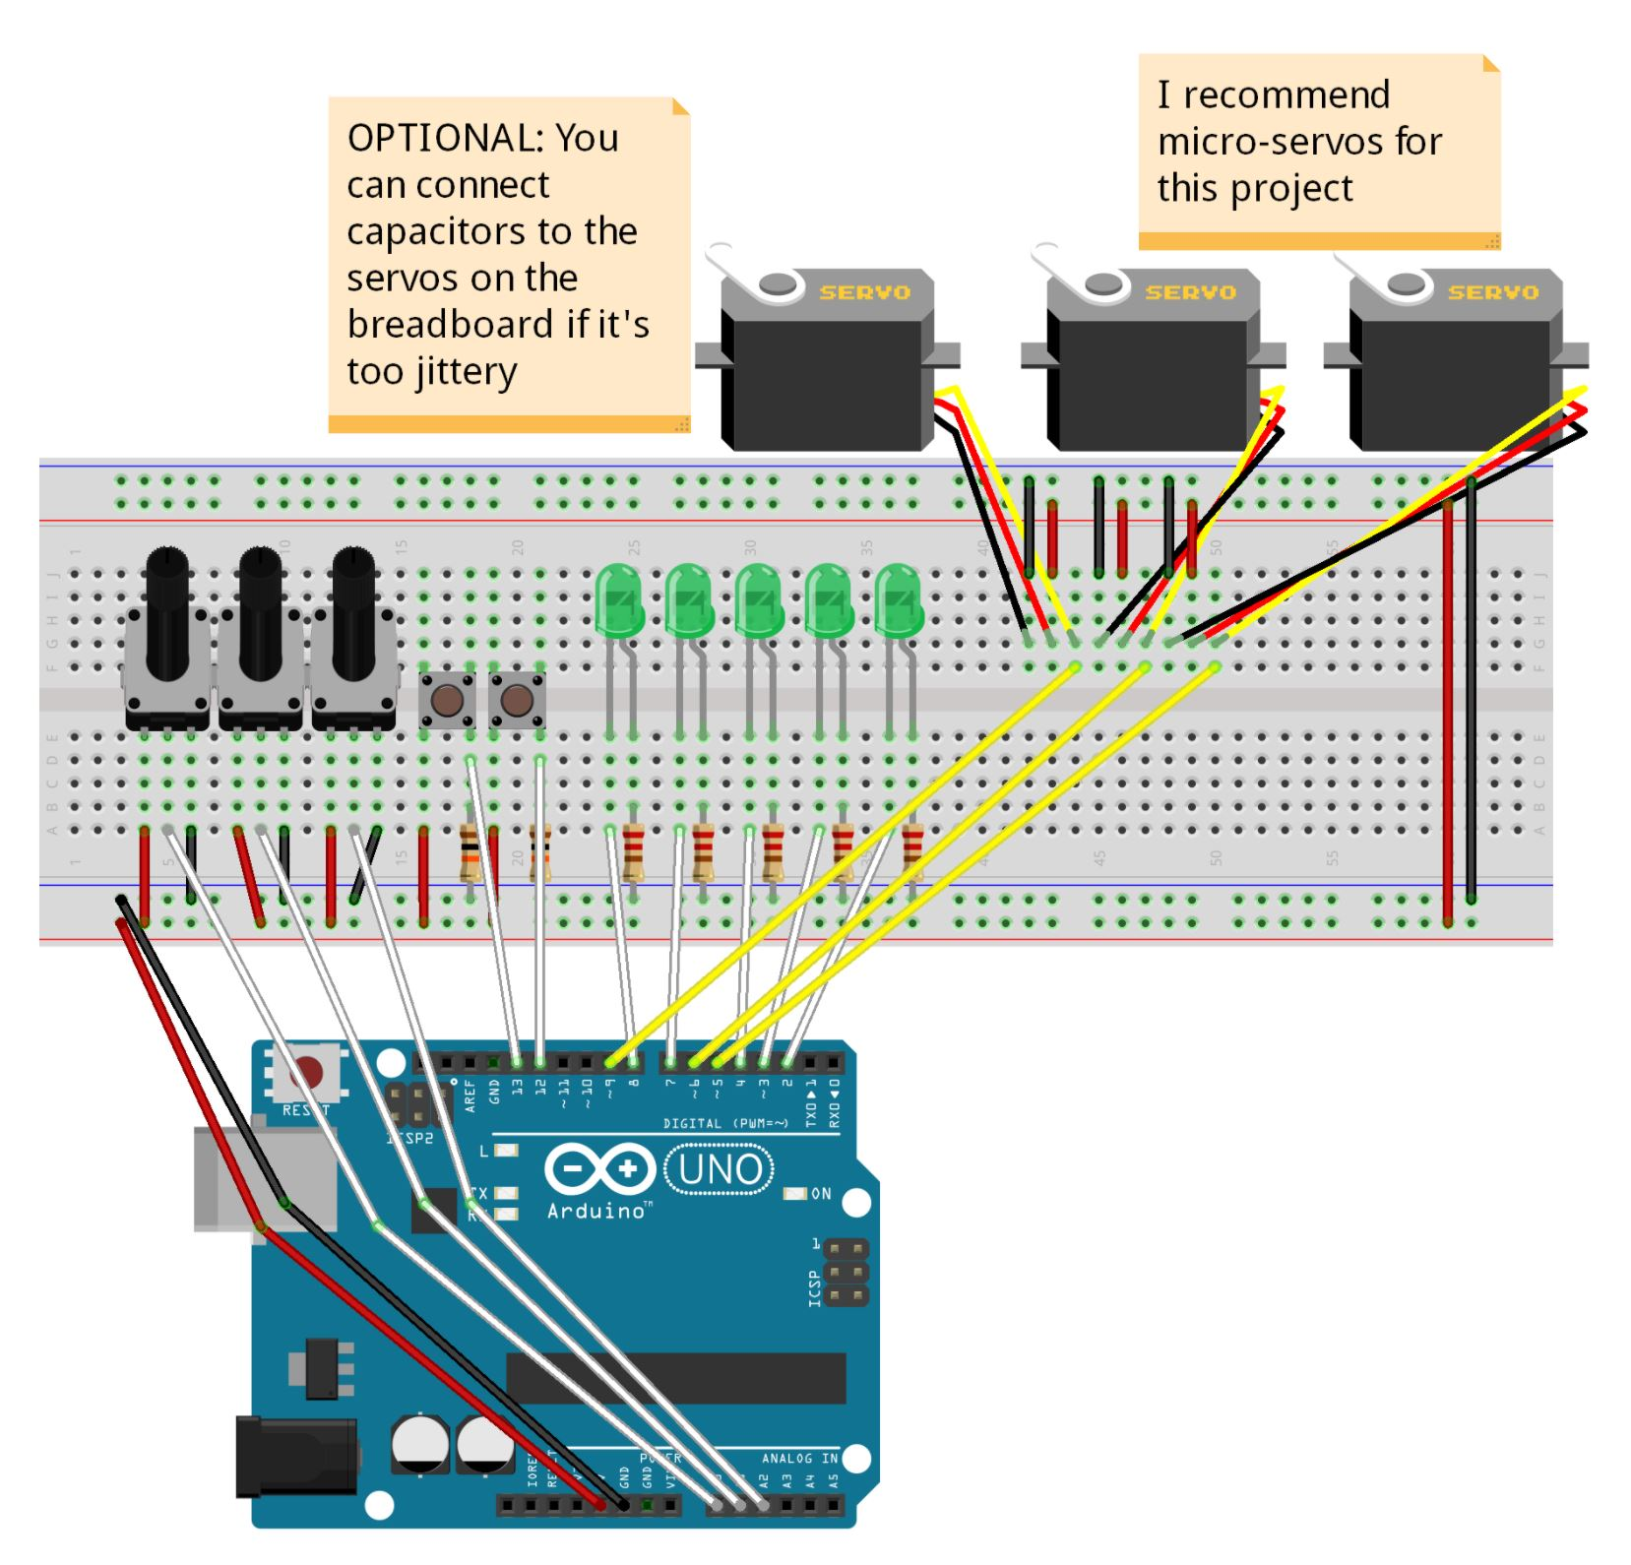
Robot Arm Circuit
Connect Potentiometers to Pins A0, A1, & A2
Connect Motors to PWM Pins 5, 6, & 9

Slide 5
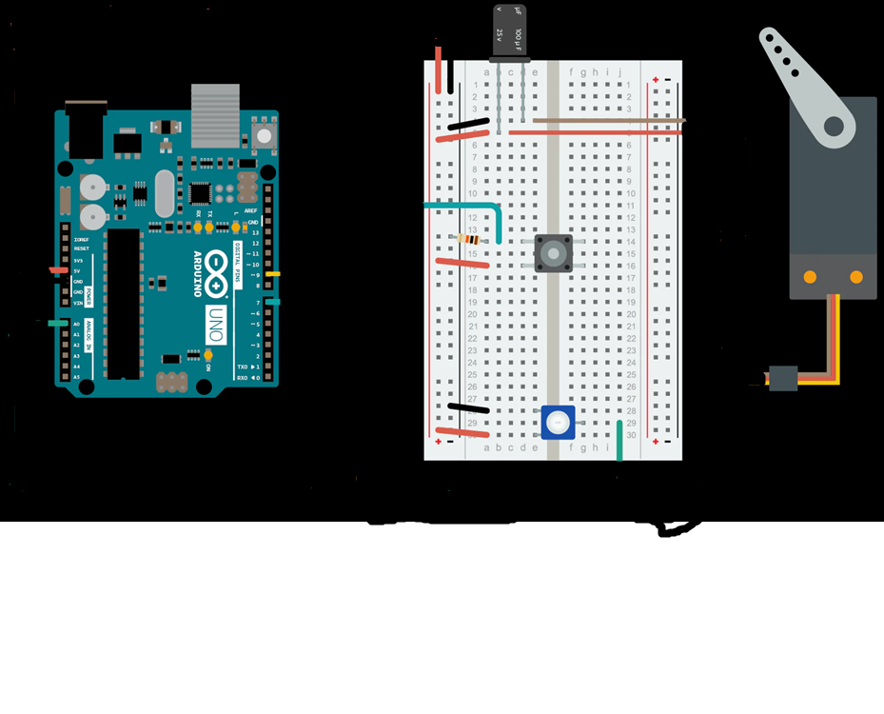
Optional
Add capacitors in between the motors and positive/negative wires for cleaner movement

Slide 6
Finish Robot Arm - Code

Slide 7
Place the Commands in Order
#include <Servo.h>
int pot1Angle; //Potentiometer angles
int pot2Angle;
int pot3Angle;
int pot1Val; //Potentiometer values
int pot2Val;
int pot3Val;
const int pot1 = A0; //Potentiometers
const int pot2 = A1;
const int pot3 = A2;
Servo servo1; //Servo Motors
Servo servo2;
Servo servo3;
void setup() {
}
void loop() {
}

Slide 8
Fill in the Blanks
void setup(){
}
void loop() {
}
Serial.begin(9600);
servo1.attach(5); // Set up everything and will run once
//attach servos and define the pin modes
servo2.attach(6);
servo3.attach(9);
// put your main code here, to run repeatedly:
pot1Val = analogRead(pot1); // This will read the values from the potentiometers
pot1Angle = map(pot1Val, 0, 1023, 0, 179); //This will map the values from the //potentiometers to values the servos can use
pot2Val = analogRead(pot2);
pot2Angle = map(pot2Val, 0, 1023, 0, 179);
pot3Val = analogRead(pot3);
pot3Angle = map(pot3Val, 0, 1023, 0, 179);
servo1.write(pot1Angle); // These will make the servos move to the mapped angles
servo2.write(pot2Angle);
servo3.write(pot3Angle);
delay(300);

Slide 9
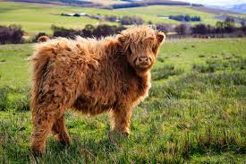

Code
#include <Servo.h>
Servo servo1; //Servo Motors
Servo servo2;
Servo servo3;
const int pot1 = A0; //Potentiometers
const int pot2 = A1;
const int pot3 = A2;
int pot1Val; //Potentiometer values
int pot2Val;
int pot3Val;
int pot1Angle; //Potentiometer angles
int pot2Angle;
int pot3Angle;
void setup() {
servo1.attach(5); // Set up everything //and will run once; attach servos and //define the pin modes
servo2.attach(6);
servo3.attach(9);
Serial.begin(9600);
}
void loop() {
// put your main code here, to run repeatedly:
pot1Val = analogRead(pot1); // This will read the values from the potentiometers
pot1Angle = map(pot1Val, 0, 1023, 0, 179); //This will map the values from the //potentiometers to values the servos can use
pot2Val = analogRead(pot2);
pot2Angle = map(pot2Val, 0, 1023, 0, 179);
pot3Val = analogRead(pot3);
pot3Angle = map(pot3Val, 0, 1023, 0, 179);
servo1.write(pot1Angle); // These will make the servos move to the mapped angles
servo2.write(pot2Angle);
servo3.write(pot3Angle);
delay(300);
}

Slide 10
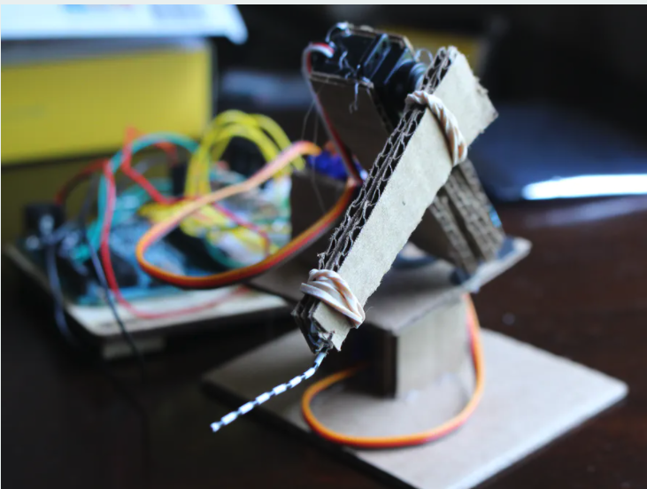
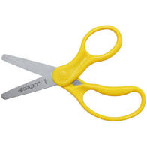
Finish Robot Arm – Build the Arm

Slide 11
Stand Ups!

Slide 12
Resources Review:
Student kit (all the circuit diagrams and code we used in the club): https://studentkit.arduino.cc/
Arduino tutorials: https://www.arduino.cc/en/Tutorial/HomePage?from=Main.Tutorials
MIT’s Scratch program is a great stepping stone that uses block coding, allowing you to learn the structure of programming before learning the actual languages themselves.
Code.org provides numerous resources connected to coding for those interested in learning the basics.
Code Academy is an interactive guide to learning multiple languages like JavaScript, HTML/CSS, and more.
Khan Academy has instructional courses on computer programming and computer science, it is an especially good resource for learning how to animate with code.
Also if you have any computer science classes offered at your school, I highly recommend taking them.
Typershark or any basic typing tutorial/software/class. Might seem boring, but proper typing skills will pay off in the future a thousand times over – you don’t want something so simple holding you back!
Maybe robotics and programming isn’t as interesting as you thought it would be, or maybe it’s just not enough! Explore these adjacent fields: Data Science, Robotics, Graphic Design, Engineering, Cybersecurity, Hacking, Machine Learning, Natural Language Processing, Network Design, Website creation.

Slide 13
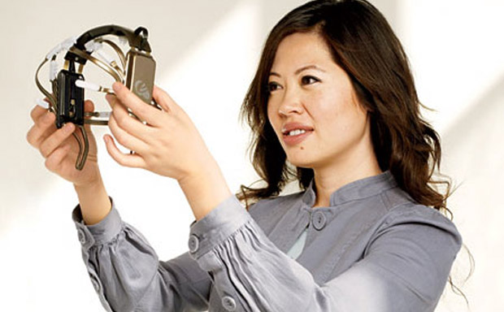
Women in Tech Spotlight: Tan Le
Accomplishments
Tan Le is the CEO and founder of Emotiv - a bioinformatics company.
The company is exploring a new “remote control” where a headset uses EEG technology to control digital devices by reading brain activity.
She is a refugee from Vietnam at age 4, she entered college at 16 and has since become a vital young leader in her home country of Australia. She attended Monash University in Melbourne, Australia where she studied law and commerce.
https://www.ted.com/talks/tan_le_a_headset_that_reads_your_brainwaves

